Slide 1

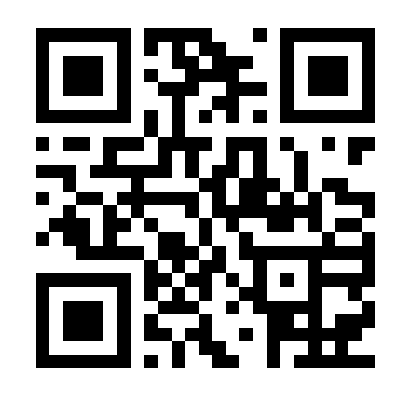
To Record Your Attendance by SMS Text:
1. Make sure you have the SMS texting feature enabled by logging into your account at cce.geisinger.edu.
2. Click the MOBILE tab and add your ten-digit cell phone number.
Receive your credit instantly by texting the following code:
_ _ _ _ _ _
to
570-605-4723

